Slide 1
3D Mobile Application for Learning Human Brain.

Slide 2
Our Team
Team Members:
Mohammad Hasnain
Sajjad Ali
Mujeeb Ahmed
Supervised by:
Dr. Ahsanullah Abro

Slide 3
Agenda
Introduction
Overall System Description
External Interface Requirements
Functional Requirements
Non-Functional Requirements
Conclusion

Slide 4
Introduction
Purpose of Document
Intended Audience
Project Objective
Interactive 3D visualization of the human brain
Detailed information on different parts of the brain
Information on the functions of each part of the brain
Quizzes and assessments to test the user's understanding

Slide 5
Introduction
Not in Scope
Integration with other systems or applications.
Any hardware requirements beyond a device with an Android operating system and access to the Google Play Store.
User data storage and management.
User authentication or login functionality.
User accounts or profiles.
Advertising or in-app purchases.
User feedback or support mechanisms.
Accessibility features for individuals with disabilities.
Technical support or maintenance of the application.
Compliance with legal or regulatory requirements beyond those required for distributing an Android app via the Google Play Store.

Slide 6
Overall System Description
Project Background
The 3D android application for the human brain is a tutorial app that provides a unique and interactive way of learning about the human brain.
Project Objectives
To design and develop an interactive User Interface to learn about the human brain using 3D models.
To offer to learn to users about the human brain and its different parts of the human brain and how they work.
To provide an engaging learning user experience to understand the human brain for students, educators, and even anyone who is of his/hers interest.

Slide 7
Stakeholders
Users
Development Team
Project Manager
Investors
Educators
Medical Professionals

Slide 8
Operating Environment
The operating environment for the 3D Android application for the human brain consists of the following requirements:
Hardware Requirements: The application will run on any Android device with a minimum of 2GB of RAM and a quad-core processor.
Software Requirements: The application requires the latest version of the Android operating system to be installed on the device.
Network Requirements: The application requires an active internet connection to access online resources.

Slide 9
System Constraints
The system constraints for the 3D Android application for the human brain are:
Memory Constraints
Performance Constraints
Connectivity Constraints
User Constraints
It is important to note that these constraints may change as the development of the application progresses and new technologies become available.

Slide 10
Assumptions and Dependency
Assumptions:
It is assumed that users have basic knowledge of human anatomy and the structure of the human brain. The application will not provide a comprehensive introduction to these concepts, but rather build on existing knowledge to provide a deeper understanding of the human brain.
Dependencies:
The development of the application is dependent on the availability of 3D models and educational resources, which will be sourced from reputable online sources. The application may also require the use of third-party libraries and software tools for the implementation of certain features, such as 3D rendering and animation.

Slide 11
Assumptions and Dependency
Technical Dependencies:
The application requires the use of the Unity 3D game engine to build and deploy the application, as well as the Android SDK for deployment to the Android platform. The development team must ensure that all required tools and technologies are available and properly configured prior to the start of development.
Resource Dependencies
The development of the application requires the availability of qualified software developers, designers, and project managers. The development team must ensure that all necessary personnel is available and properly trained to perform their roles effectively.

Slide 12
External Interface Requirements
Hardware Interface
Device requirements:
The type of devices the application will run on, such as smartphones or tablets, with the minimum operating system and screen resolution requirements.
Storage requirements:
The amount of storage space required to install the application and its associated files
Input devices:
The types of input devices required to interact with the application, such as touch screens or buttons.
Output devices:
: The types of output devices required to display the application, such as displays or speakers.
Connectivity:
Any connectivity requirements, such as Wi-Fi or cellular data, needed to access the application's content or features.

Slide 13
External Interface Requirements
Software Interface
Operating System compatibility:
The operating system versions the application will support.
APIs:
Any APIs the application will use to access external data or services, including any security considerations.
Third-party software:
Any third-party software that the application will rely on, such as libraries or plugins.

Slide 14
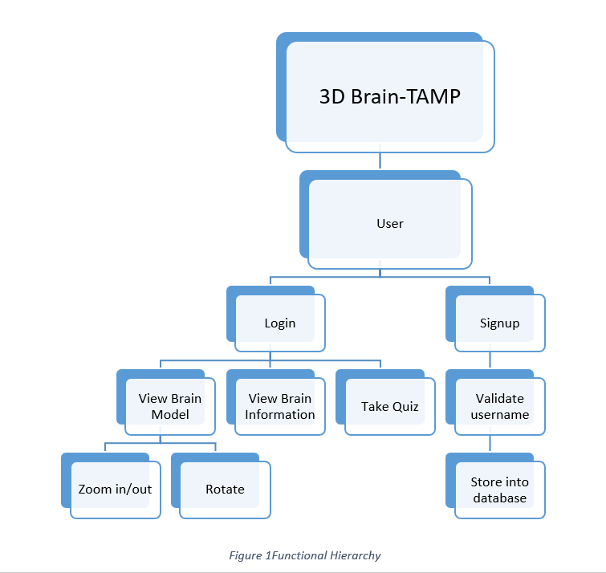
Functional Requirements
Functional Hierarchy
The functional hierarchy of the 3D android application for the human brain can be divided into the following modules:

Slide 15
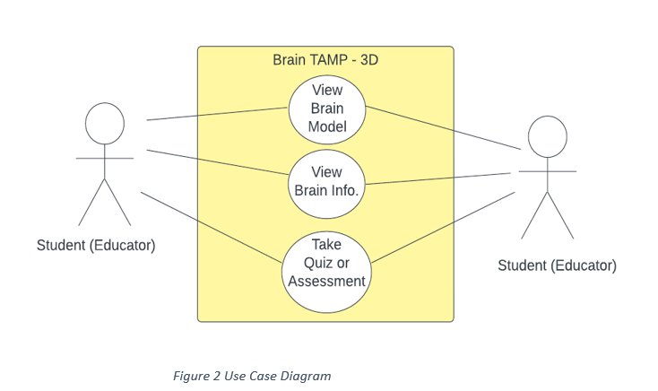
Use Cases

Slide 16
Non-Functional Requirements
Performance Requirements
The application should run smoothly on Android devices with minimum system requirements and not have any lag or delay in loading the 3D models and information.
Reliability Requirements
The application should be reliable and have minimal downtime. The application should not crash or have any unexpected errors.
Security Requirements
The application should be secure from any unauthorized access or data theft. The personal information of the users should be protected and not shared with any third parties.
User Documentation

Slide 17
Conclusion
Our 3D Android application for learning the human brain from a taxonomical, anatomical, physiological, and morphological perspective is a unique and valuable tool for students, educators, and anyone who wants to explore the complexities of the human brain.

Slide 18
Thank you!

